Slide 1


Project creation
11.09.2023
Autor: Salah Harhira

Slide 2
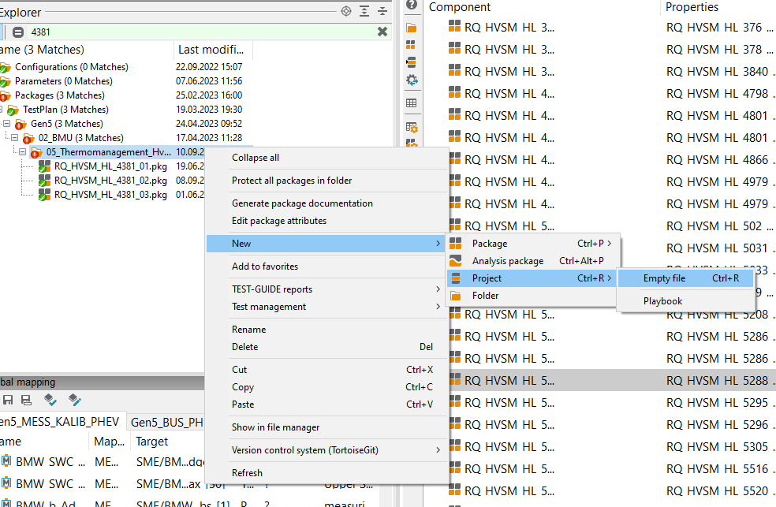
The regular method to create a project for you package is to create an empty project and drag and drop your package one by one

Slide 3
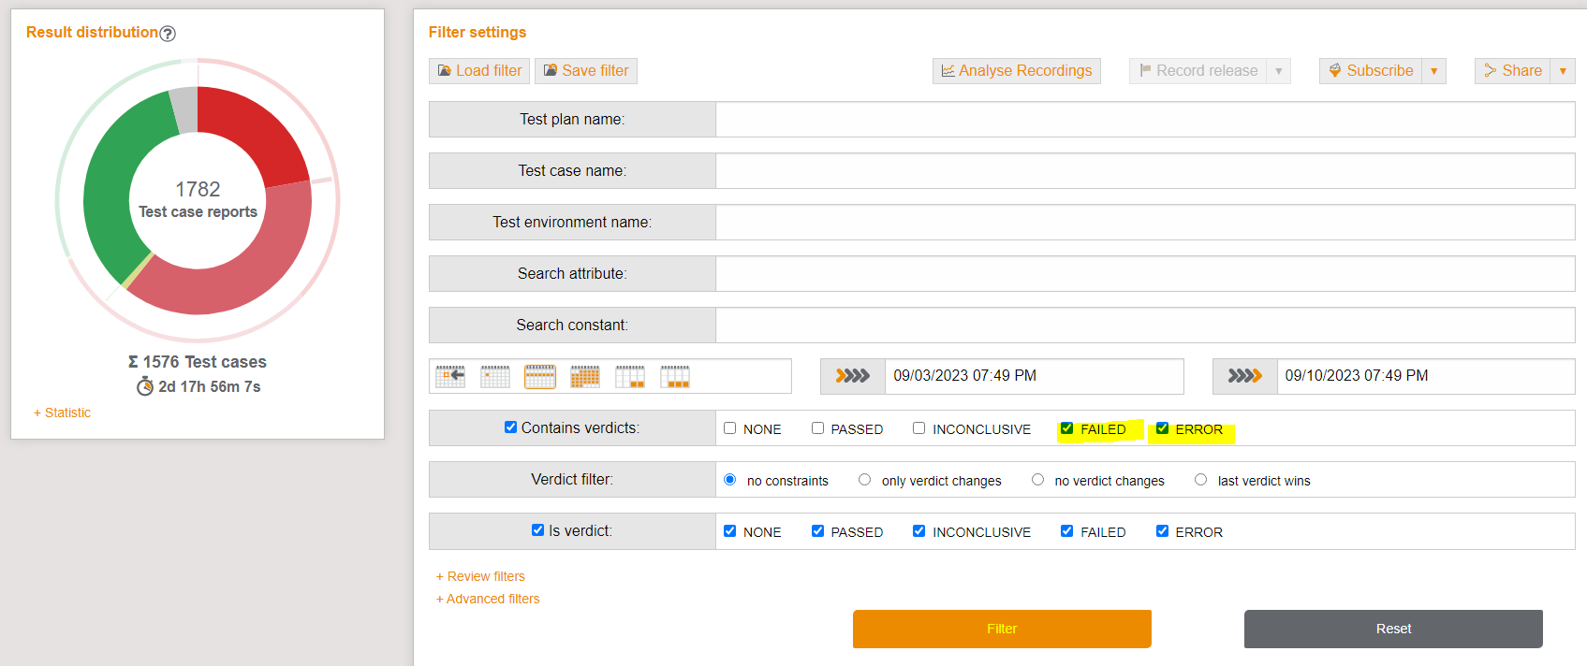
If you have a lot of package this method will be helpful .
First of all you need to extract the excel file for your error / failed packages from test guide

Slide 4
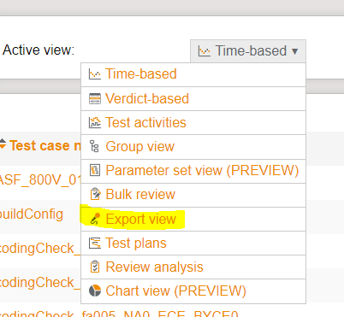
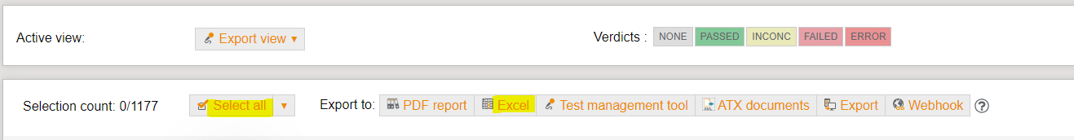
Then go to active view and chose the export view
Then select all the packages and press excel to download the generated excel file

Slide 5
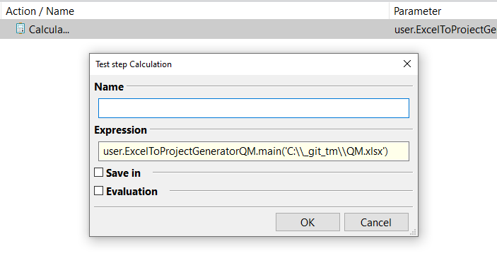
1) Press ( ctrl+p) to create an empty package
2) Add a calculation bloc to your package
3) Add : user.ExcelToProjectGeneratorQM.main(‘path’)
With path is the path of the excel file already generated from test guide

Slide 6
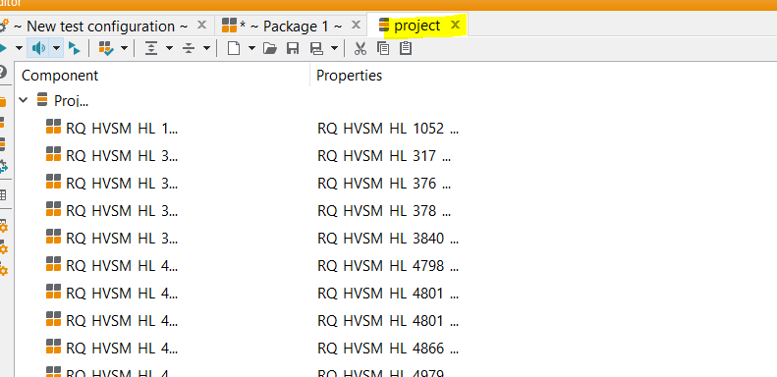
5) And then run you package and you will get the project in a new tab

